Slide 1
Describing Data
Notes:
https://www.utdallas.edu/~scniu/OPRE-6301/documents/What_Is_Statistics.pdf

Slide 2
Introduction
Descriptive Statistics allow to characterize data based on its properties.
There are four major types of descriptive statistics:
Measures of Frequency
Measures of Central Tendency
Measures of Dispersion or Variation
Measures of Position

Slide 3
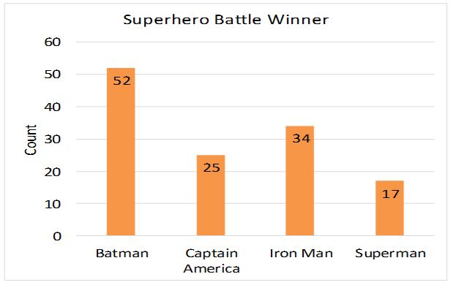
Measures of Frequency
Count, Percent, Frequency
Shows how often something occurs
Use this when you want to show how often a response is given

Slide 4
Measures of Central Tendency
Mean, Median, and Mode
Locates the distribution by various points
Use this when you want to show how an average or most commonly indicated response

Slide 5
Measures of Dispersion or Variation
Describe how similar or varied the set of observed values are.
Include the
range,
quartiles and the interquartile range,
variance and
standard deviation
Can be measured for quantitative data.
Use this when
You want to show how "spread out" the data are.
It is helpful to know when your data are so spread out that it affects the mean.

Slide 6
Why do we measure spread?
Summarizing the dataset can help us understand the data.
The mode, median, and mean summarize the data into a single value. This is only part of the 'picture' that summarizes a dataset.
Measures of spread summarize the data in a way that shows how scattered the values are and how much they differ from the mean value.

Slide 7
Variance and Standard Deviation
Variance: The average of the squared differences from the mean.
Standard Deviation: The square root of the variance and is used to measure distance from the mean.

Slide 8
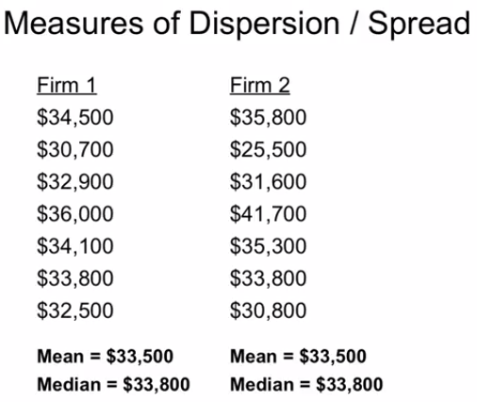
Example
Mean/Median is same for both.
How to define that both datasets are different?

Slide 9
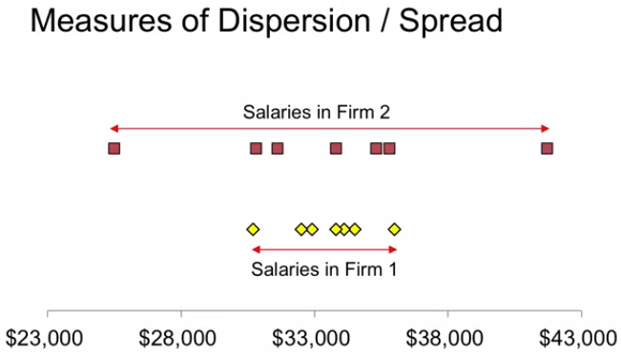
Example

Slide 10
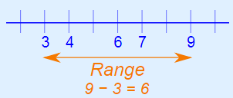
Range
Difference between Maximum and Minimum
Range = Max Value – Min Values
Range of salaries in firm 1
=36000 – 30700 = 5300
Range of salaries in firm 2
=41700– 25500= 16200

Slide 11
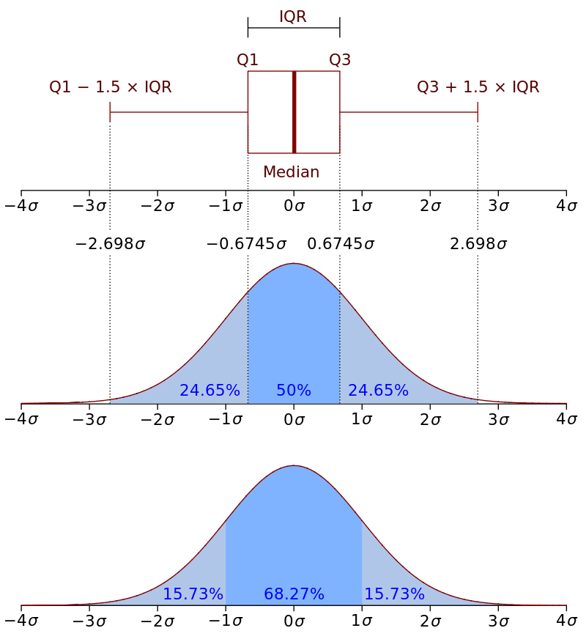
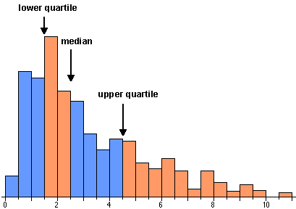
Measures of Position
Percentile Ranks, Quartile Ranks

Slide 12

Inter Quartile Range (IQR)
Defines middle 50% of data.
25% data of the left and 25% of the right will be discarded.

Slide 13
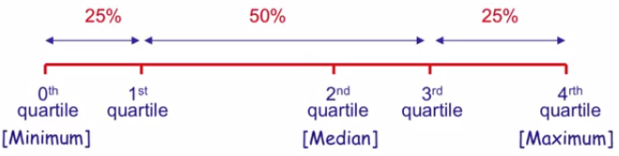
Inter Quartile Range (IQR)
1st Quartile: Is the number such that 25% of the observations are <= to this number.
3rd Quartile: Is the number such that 75% of the observations are <= to this number.
2nd Quartile: Is the median.
Minimum number in the range is at 0th Quartile.
Maximum number in the range is at 4th Quartile.

Slide 14
Thanks

